Slide 1
KeyStone II Interrupts

Slide 2
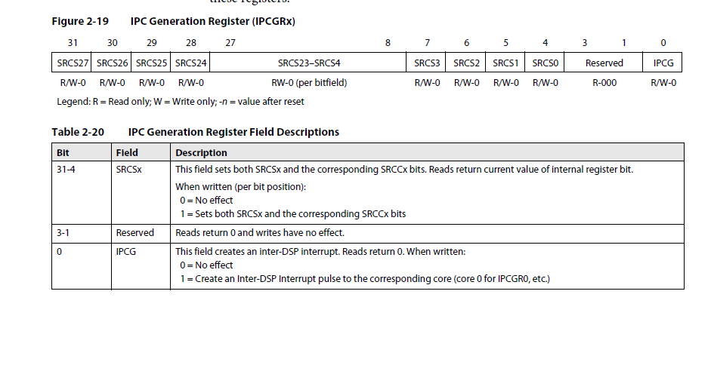
IPC registers

Slide 3
C66 CorePac Primary Interrupts
124 events + 4 combined events
Event number 20 – SRIO, event 17 – PCIe, IPC event
42 events from the device interrupt controllers

Slide 4
ARM CorePac Primary Interrupts
4 IPC events
4 PCIe legacy interrupts
8 PCIe MSI interrupts
24 SRIO interrupts
8 interrupts from each EDMA controller (5)
32 interrupts from the device interrupt controllers

Slide 5
C66 CorePac Secondary Interrupts
474 secondary events
8 from each EDMA controller (5)
4 PCIe legacy interrupts
4 PCIe MSI interrupts
20 SRIO interrupts
2 Hyperlink interrupts (0 and 1)

Slide 6
EDMA and Hyperlink Interrupts
479 secondary events
24 SRIO interrupts
2 Hyperlink interrupts
8 IPC interrupt generations

